Slide 1





Embedding the Green Events Code of Practice (GECoP) in Licensing
Making the case for sustainability standards in live event licensing
Notes:
Chris

Slide 2


Project partners
With thanks to project funders:
Matched by participating local authorities.

Slide 3
Agenda
Background
Why GECoP Matters
Current licensing framework
How GECoP Fits into Licensing
Adoption Pathways
Benefits of GECoP Adoption
Example Licence Condition
Practical Next Steps
Conclusion
Resources
Notes:
Richard – 5 mins

Slide 4
Intro: Background to GECoP
Notes:
Chris

Slide 5






Background
GECoP is a voluntary, evidence-based sustainability standard for live outdoor events in the UK.
Industry-adopted, low-cost framework for quick, consistent assessment by non-experts.
Can be integrated into site permissions, funding, licensing, local authority-run events (voluntary or mandatory).
Aligned with global, national and sector frameworks (referenced in the Purple Guide Environmental Chapter).
Developed by event practitioners; piloted across 10 local authorities; updated Sept 2025.

Slide 6
Why GECoP matters?
Provides a nationally recognised sustainability benchmark
Aligns live events with climate science and industry best practice
Supports licensing objectives: public safety & prevention of public nuisance
Consistency: avoids patchy, ad-hoc environmental conditions

Slide 7
Current Licensing Framework
Licensing Act 2003: four statutory objectives
– Prevention of crime & disorder
– Public safety
– Prevention of public nuisance
– Protection of children from harm
No explicit environmental objective
Environmental issues tied to public safety/ nuisance.

Slide 8
How GECoP Fits into Licensing
Can be integrated into premises licenses for large events for the below areas.
Can be requested in event management plans and included in EMP templates.
Used as benchmark for licence conditions and reporting.
(There is a draft Licensing Policy & EMP template available in the GECoP resource pack).
Waste & litter management
Traffic & air quality
Energy & offsite emissions
Site restoration and biodiversity
Procurement & single-use plastics
Waste management plan
Travel plan
Diesel generator restrictions
Biodiversity survey
Single-use plastic ban for vendors and bars
The next iteration of GECoP resources in Mid-2026 will provide model license conditions.

Slide 9
Adoption Pathways
Reference GECoP in council licensing policy
Require applicants to submit DATE assessment + Environmental Plan
Attach licence conditions requiring GECoP compliance
Mandate post-event reporting aligned with GECoP metrics
Support smaller events with scalable templates.

Slide 10
Benefits for local authorities
For organisers
  Clear expectations and reduced duplication
For councils
  Confidence in credible standards, easier enforcement
For communities
  Reduced noise, waste, pollution, improved legacy
For industry
  Level playing field, accelerates sustainability transition

Slide 11
Example Licence Condition
“The licence holder shall operate the event in accordance with the Green Events Code of Practice (Vision for Sustainable Events / Purple Guide), including completion of an aligned assessment and submission of a post-event environmental report.”

Slide 12
Practical Next Steps
Councils
  Update Statement of Licensing Policy to reference GECoP
Organisers
  Integrate DATE assessment into Event Management Plan
Responsible authorities
  Use GECoP for consistent evaluation
Start voluntary adoption
  Build towards standard practice

Slide 13
GECoP can play the same role for sustainability that the Purple Guide plays for safety:
A clear, trusted reference standard
A practical tool for councils, organisers & communities
Pathway to a more sustainable UK live events sector.

Slide 14
Resources

Slide 15
GECoP resources
The Green Events Code of Practice (2025) [PDF]
About GECoP: Internal stakeholders in Local Authorities [PPT]
About GECoP: Introduction for Event Organisers [PPT]
DATE Tool set-up guide [video - MP4]
Draft Licensing Policy Wording [WORD]
Template: Environmental Management Plan for Events [WORD]
Example press release [WORD]
National GECoP Pilot (2024) Report [PDF]
Access all of the resources on the Vision for Sustainable Events website >>
https://visionsustainableevents.org/green-events-code-of-practice-resources/

Slide 16
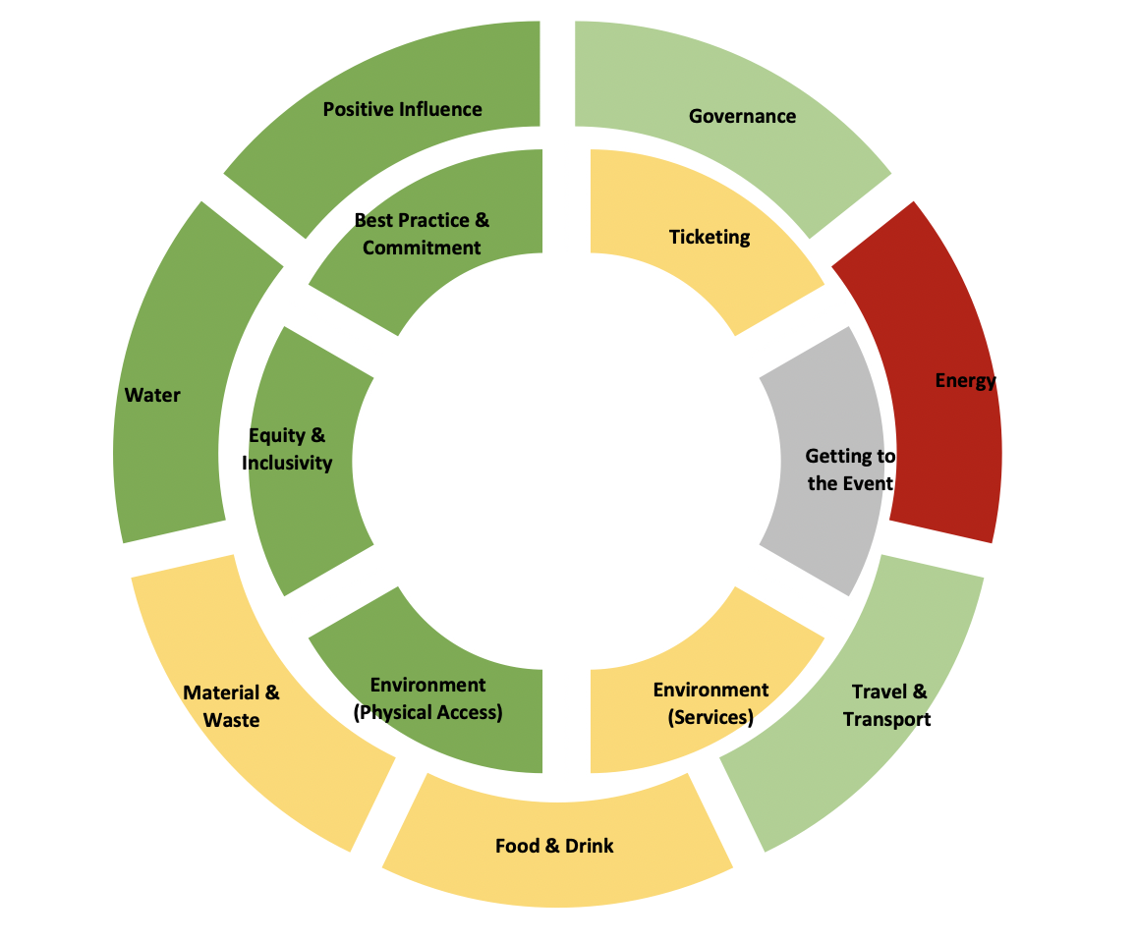
What is the DATE Tool?
The Donut Advisory Toolkit for Events
A simple tool in the form of an online survey or offline Excel document
The questions relate to the impact areas of the GECoP
It provides a traffic light indicator and score against each area.

