Slide 1





For Event Organisers
Notes:
Chris

Slide 2


Project partners
With thanks to project funders:
Matched by participating local authorities

Slide 3
Agenda
Background
Benefits for event organisers
Benefits for local communities
Implementing GECoP in your local authority
Adoption process
  Site permissions
  Licencing
  Event management plans
  Funding & procurement
  Working groups
Assessment with the DATE Tool
Resources
Notes:
Richard – 5 mins

Slide 4
Intro: Background to GECoP
Notes:
Chris

Slide 5






Background
GECoP is a voluntary, evidence-based sustainability standard for live outdoor events in the UK.
Industry-adopted, low-cost framework for quick, consistent assessment by non-experts.
Can be integrated into site permissions, funding, licensing, local authority-run events (voluntary or mandatory).
Aligned with global, national and sector frameworks (referenced in the Purple Guide Environmental Chapter).
Developed by event practitioners; piloted across 10 local authorities; updated Sept 2025.

Slide 6
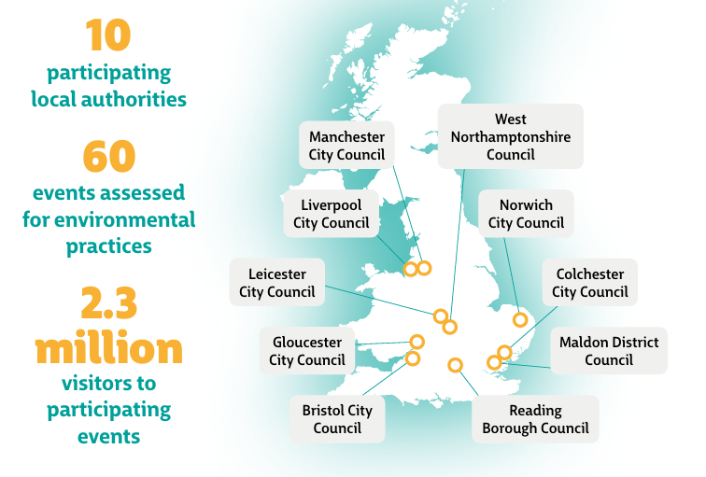
Pilot Project - Local Authorities
Notes:
This was a national pilot and so was only focused on LAs in England.
We had a mix of large and smaller LAs, covering N,S,E,W
Events included a mix of events by size and type - large, small & community, music, food, sports, parades and other
Some of the larger names: Reading Fest, Parklife, Love Saves the Day, Athletics Championships, Davis Cup
And then a whole range of wonderful small and medium events
This really helped understand whether an assessment against the same benchmark of expectations at GECoP would work at all levels
Here is the split of the 60 events:
By type:
Over 50% community/cultural
¼ were music
Also sporting events

Slide 7



What is the purpose of
the code?
The code provides:
A clear and robust benchmark for sustainability practices for all stakeholders across the outdoor festival industry
Common targets for 2030 impact reductions (watch this space!)
Context for relationship with Local Authorities – best practice for SAG groups and site permissions

Slide 8








Key impact areas:
Positive influence
Governance / strategy
Energy
Biology & ecological management
Materials and waste
Water
Food
Transportation

Slide 9




Why does this matter for organisers?
Growing expectation from local authorities for credible sustainability measures.
Funders, audiences and partners expect visible climate and environmental action.
Avoids each council creating its own standards.
Stay ahead of future regulation and build relationships with stakeholders.

Slide 10





Benefits for Event Organisers & Industry
Clear, industry-endorsed benchmark — reduces uncertainty & duplication.
Based on achievable practices from event practitioners (real-world relevance).
Structured assessment plus signposting to resources increases organisers’ confidence and capability
Creates a level playing field and shared expectations.
Accelerates transition to low-impact event practices across the sector.

Slide 11


Benefits for Communities
Stronger assurances on noise, waste, pollution and site legacy.
Better local outcomes through consistent minimum standards.

Slide 12
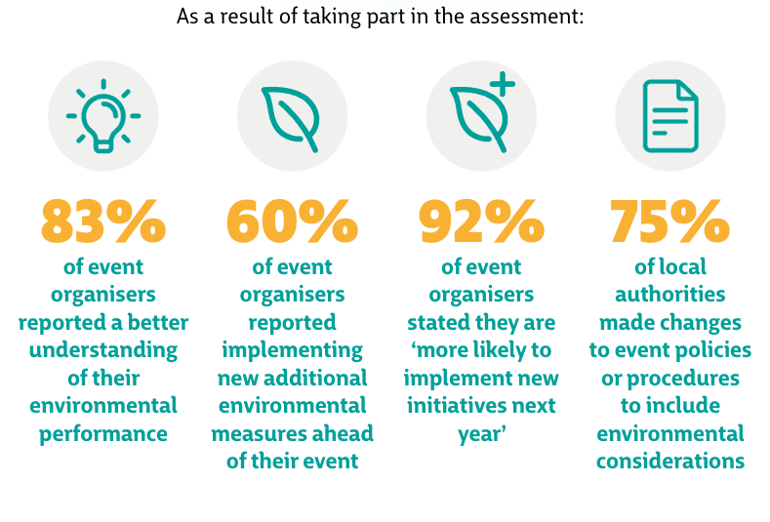
Pilot outcomes (national pilot 2024)
Rank | Actions taken by events in 2024
1 | Sustainable energy measures
2 | Introduced reusable cups
3 | Engaged with stakeholders
4 | New policy, strategy or action plan
5 | New data collection for insights
Notes:
Richard
Just by conducting the GECoP assessment, both local authorities and events improved the environmental actions they were taking…
[Run through stats]
So - greater understanding, greater confidence and more actions being taken

Slide 13
Implementing GECoP in your event
Notes:
richard

Slide 14
Smaller vs larger events (scale & expectations)
GECoP is designed for all sizes — from <1,000 community events to >80,000 capacity festivals.
Smaller/community events: encouraged to take realistic first steps (e.g. waste management, travel plan).
Larger events: expected to go further (renewables, biodiversity, advanced policies).
It’s about year-on-year improvements
Rank | AIF/LIVE size categories
Micro | < 1,000 capacity
Small | < 20,000 capacity
Medium | <50,000 capacity
Large | < 80,000 capacity
Major | > 80,000 capacity

Slide 15
How it works for organisers
Complete a short DATE Tool assessment (15–20 minutes).
Review the DATE feedback and signposting to resources, case studies and guidance.
Identify where you can make improvements for the upcoming event
Share assessment with local authorities or funders (where required).
Use results to plan improvements year-on-year.

Slide 16
Using the DATE Tool for the GECoP Assessment

Slide 17
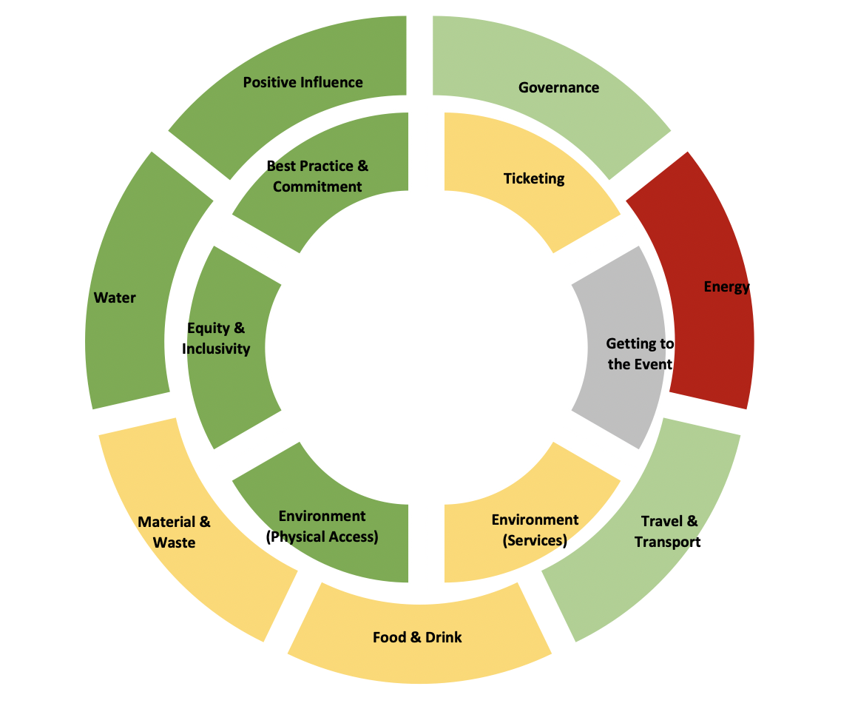
What is DATE
The Donut Advisory Toolkit for Events
A simple free-to-use tool in the form of an online survey or offline Excel document
The questions relate to the impact areas of the GECoP
It provides a traffic light indicator and score against each area:
  Energy
  Travel & Transport
  Food & Drink
  Materials & Waste
  Water
  Governance
  Positive influence

Slide 18


Collaborative working
By participating your event can have input and improve services provided on local authority event land:
Liverpool City changed their River of Lights event to grid electricity following the review process.
Reading started a working group with event organisers that fed into their 5-year Climate Emergency Strategy.

Slide 19
Addressing event concerns

Slide 20
Its voluntary, do we have to do it?
It will help you identify easy wins that can help with funding, audience communications.
Events won’t be penalised for low scores.
Completing the assessment can help gaps in local service provision in an area which your local authority can address.

Slide 21




Our team don’t have sustainability experience or capacity
There are quick reference guides & training to access.
Example of actions you could take:
Switch to renewable/ low-emission power supply e.g. onsite grid electricity.
Introduce a reusable cup scheme.
Provide clear recycling and waste management systems.
Create a travel plan and advice for audiences and staff (cycling, public transport, car share).

Slide 22
Resources

Slide 23
Share the resources you have as a local authority

