Slide 1





For Local Authority Stakeholders
Notes:
Chris

Slide 2


Project partners
With thanks to project funders:
Matched by participating local authorities.

Slide 3
Agenda
Background
Challenges it addresses for local authorities
Benefits for local authorities & communities
Benefits for event organisers
Implementing GECoP in your local authority
Adoption process
  Site permissions
  Licencing
  Event management plans
  Funding & procurement
  Working groups
Assessment with the DATE Tool
Resources
Notes:
Richard – 5 mins

Slide 4
Intro: Background to GECoP
Notes:
Chris

Slide 5






Background
GECoP is a voluntary, evidence-based sustainability standard for live outdoor events in the UK.
Industry-adopted, low-cost framework for quick, consistent assessment by non-experts.
Can be integrated into site permissions, funding, licensing, local authority-run events (voluntary or mandatory).
Aligned with global, national and sector frameworks (referenced in the Purple Guide Environmental Chapter).
Developed by event practitioners; piloted across 10 local authorities; updated Sept 2025.

Slide 6
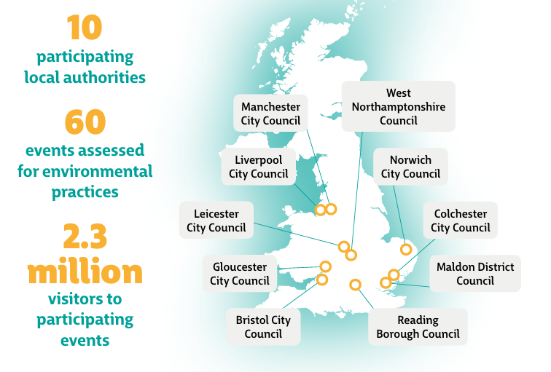
Pilot Project - Local Authorities
Notes:
This was a national pilot and so was only focused on LAs in England.
We had a mix of large and smaller LAs, covering N,S,E,W
Events included a mix of events by size and type - large, small & community, music, food, sports, parades and other
Some of the larger names: Reading Fest, Parklife, Love Saves the Day, Athletics Championships, Davis Cup
And then a whole range of wonderful small and medium events
This really helped understand whether an assessment against the same benchmark of expectations at GECoP would work at all levels
Here is the split of the 60 events:
By type:
Over 50% community/cultural
¼ were music
Also sporting events

Slide 7



What is the purpose of
the code?
The code provides:
A clear and robust benchmark for sustainability practices for all stakeholders across the outdoor festival industry
Common targets for 2030 impact reductions (watch this space!)
context for relationship with Local Authorities – best practice for SAG groups and site permissions

Slide 8




What problems does GECoP address?
Funding, capacity and resource limitations within local authorities.
Lack of sustainable event expertise in council teams.
Many organisers lack capability or confidence to act on sustainability.
Majority of events are small/community-run with limited resources.

Slide 9








Key impact areas:
Positive influence
Governance / strategy
Energy
Biology & ecological management
Materials and waste
Water
Food
Transportation

Slide 10




Benefits for local authorities
Credible, enforceable sustainability measures.
Saves officer time—no need to assess bespoke environmental claims.
Off-the-shelf assessment framework and resources.
Better evidence for net-zero planning and policy.
Encourages collaborative

Slide 11
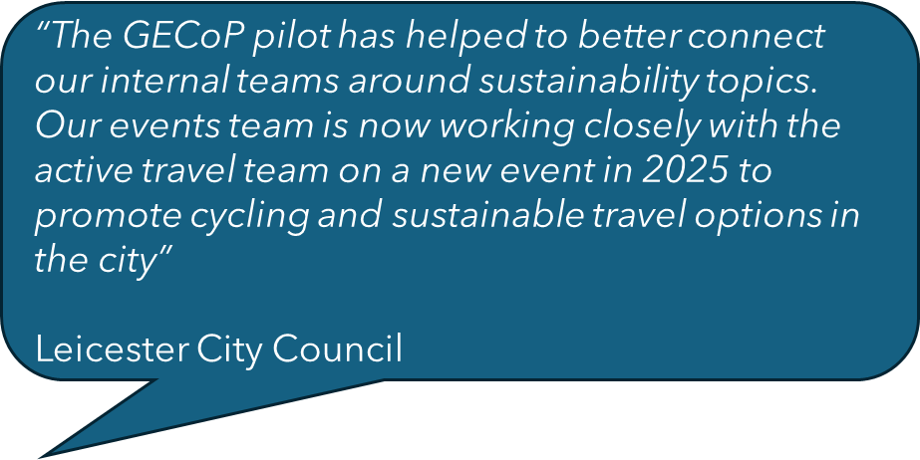
Experience of participating LA’s
  80% increased conversations with stakeholders
  Greater sense of community commitment to climate action
  Better engagement with internal teams

Slide 12


Benefits for Communities
Stronger assurances on noise, waste, pollution and site legacy.
Better local outcomes through consistent minimum standards.

Slide 13





Benefits for Event Organisers & Industry
Clear, industry-endorsed benchmark — reduces uncertainty & duplication.
Based on achievable practices from event practitioners (real-world relevance).
Structured assessment plus signposting to resources increases organisers’ confidence and capability.
Creates a level playing field and shared expectations.
Accelerates transition to low-impact event practices across the sector.

Slide 14
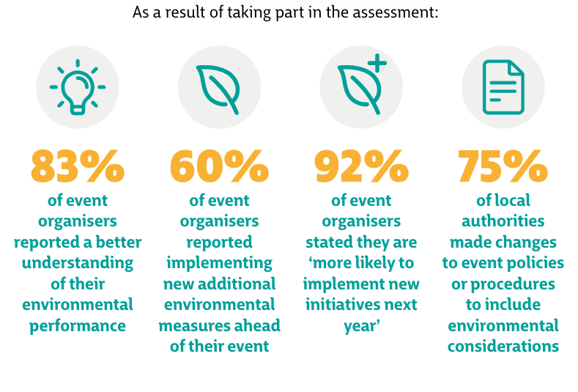
Pilot outcomes (national pilot 2024)
Rank | Actions taken by events in 2024
1 | Sustainable energy measures
2 | Introduced reusable cups
3 | Engaged with stakeholders
4 | New policy, strategy or action plan
5 | New data collection for insights
Notes:
Richard
Just by conducting the GECoP assessment, both local authorities and events improved the environmental actions they were taking…
[Run through stats]
So - greater understanding, greater confidence and more actions being taken

Slide 15
Implementing GECoP in your local authority
Notes:
richard

Slide 16
Smaller vs larger events (scale & expectations)
91% of live outdoor events are micro/small and may need tailored, realistic support.
Pilot feedback: many local authorities suggested GECoP mandatory for large events and optional for small events.
Use DATE scores for gap analysis rather than hard minimum thresholds.
Rank | AIF/LIVE size categories
Micro | < 1,000 capacity
Small | < 20,000 capacity
Medium | <50,000 capacity
Large | < 80,000 capacity
Major | > 80,000 capacity

Slide 17
Site permissions
In the pilot, most local authorites used GECoP as part of the site permissions process, including the DATE survey is part of the application process.
Local authorities can use the insights in different ways depending on the size and type of event
Bristol City Council trialled using the GECoP assessment alongside a pre-existing and more extensive set of questions to evaluate the environmental practice of events that form part of its Expression of Interest (EOI) tool
Manchester City Council embedded the assessment within the previous approach of issuing a short sustainability survey and guidance,

Slide 18
Licensing
No current environmental or climate objectives
Can be integrated into premises licenses for large events for the below areas
Many councils publish event management plan (EMP templates) and explicitly ask event organisers to include environmental sections even if not enforceable. (There is a draft Licensing Policy & EMP template available in the GECoP resource pack)
Waste & litter management
Traffic & air quality
Energy & offsite emissions
Site restoration and biodiversity
Procurement & single-use plastics
Waste management plan
Travel plan
Diesel generator restrictions
Biodiversity survey
Single-use plastic ban for vendors and bars
The next iteration of GECoP resources in Mid-2026 will provide model license conditions.

Slide 19



Funding & procurement
On the events and contracts local authorities have most control over they can:
Use GECoP to set environmental criteria for LA-run events and third-party contracts.
Require completion of DATE assessment as part of funding applications or tenders.
Bristol integrated GECoP standards into contracts, tenders and funding for all of their LA funded events.

Slide 20



Working groups
Working groups can be delivered annually or by a third party where Local Authority capacity is limited. The pilot working groups (in person meetings or online) have proven beneficial to:
Build relationships between the LA and event organisers, leading to better engagement.
Introduce the event organiser community to GECoP, increasing understanding and trust.
Provide insights to LA’s about challenges, barriers and opportunities.
Kick-start self-organising groups of committed organisers to share experiences and learn from each other.

Slide 21
Working groups case study
In Reading, a working group was established with festival organisers to apply the Green Code and share best practice.
“It has been wonderful seeing festival organisers of various size events, local suppliers and sector bodies sharing knowledge and offering advice. It has created a strong foundation for Reading’s renewed 5-year Climate Emergency Strategy (2025 – 2030).”
Councillor John Ennis - Lead Councillor for Climate Strategy and
Transport, Reading Borough Council

Slide 22
Using the DATE Tool for the GECoP Assessment

Slide 23
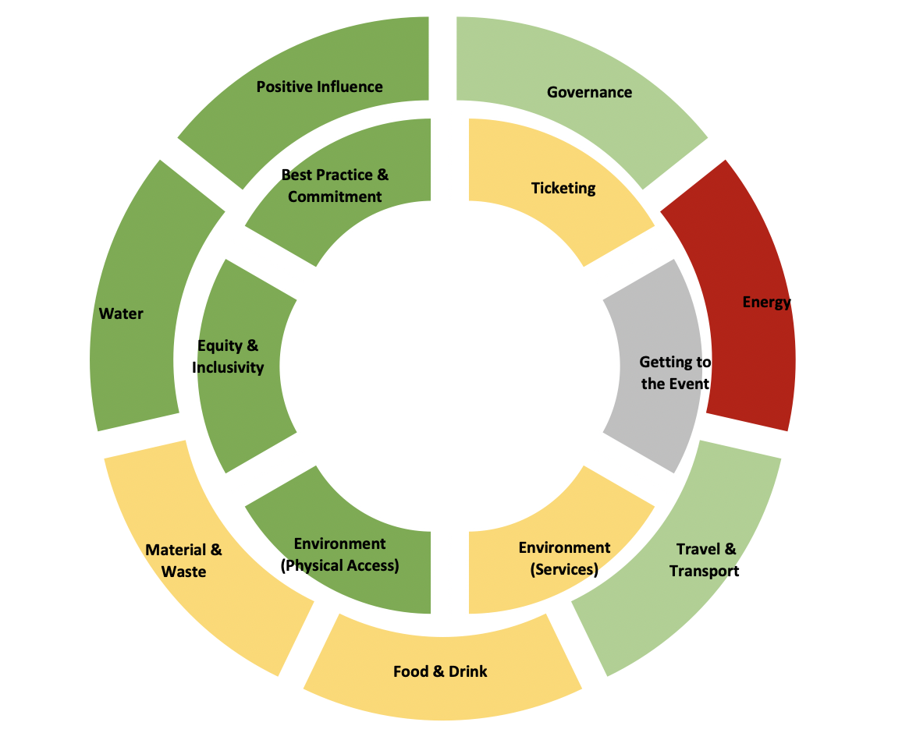
What is the DATE tool?
The Donut Advisory Toolkit for Events
A simple tool in the form of an online survey or offline Excel document
The questions relate to the impact areas of the GECoP
It provides a traffic light indicator and score against each area.

Slide 24




Using the results
The results can be used in a number of ways:
As an initial assessment of current practices of an event
To ensure events meet minimum requirements e.g. waste infrastructure
To demonstrate continuous improvement year on year against environmental commitments - scores and impact areas can be checked
As a gap analysis exercise rather than a scored assessment that penalises them. Events can provide action plans to show how they will make improvements

Slide 25

Checking against the assessment
Alternative ways to check events, where onsite assessments of events by LA’s is impractical include:
Requesting a post-event assessment to see what changes were made
Looking at year-on-year continuous improvement
Reviewing the assessments will highlight gaps in local service provision that can be addressed e.g. offering grid electricity, sufficient waste management services, or onsite water.
Liverpool City changed their River of Lights event to grid electricity following the review process.

Slide 26
Implementing in your local authority

Slide 27
Implementation process
Identify Key Internal Stakeholders
  Identify Events, Culture, Parks, Licencing Climate/Net zero colleagues who are relevant to the GECoP process.
Plan a meeting
  Convene a meeting with teams to discuss the embedding of GECoP into your strategies and processes.
Present GECoP
Use the GECoP presentation (this) to introduce the concept and discuss which of your existing event application processes can the code and the assessment tool be used.
Post-event review (Optional)
  Ask events to complete the DATE tool after the event to identify any changes they have made.
Analysis
  Identify trends and understand specific challenges and opportunities
Assess and evaluate
  Review events sustainability criteria as part of your event application processes.
Assessment
  Events complete the DATE tool assessment survey as part of the relevant process/application

Slide 28
Resources

Slide 29
GECoP resources
The Green Events Code of Practice (2025) [PDF]
About GECoP: Internal stakeholders in Local Authorities [PPT]
About GECoP: Introduction for Event Organisers [PPT]
DATE Tool set-up guide [video - MP4?]
Draft Licensing Policy Wording [WORD]
Template: Environmental Management Plan for Events [WORD]
Example press release [WORD]
National GECoP Pilot (2024) Report [PDF]
Access all of the resources on the Vision for Sustainable Events website >>
https://visionsustainableevents.org/green-events-code-of-practice-resources/

